Slide 1
CSE 11 Accelerated Intro to Programming Lecture 1
Greg Miranda, Spring 2021
This lecture is being recorded

Slide 2
Fair Notice of Class Recording Announcement
Each class online lecture for CSE 11, including this one, will be recorded and made available to students asynchronously.

Slide 3
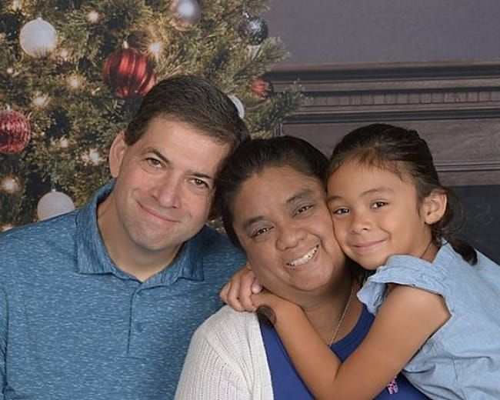
Greg Miranda
Started at UCSD in Summer 2018
Taught at private colleges (AICASD, UAT) before UCSD
Teaching Background:
5A/8B/11/12
Game Programming, Game Design, Web Programming
Background:
CE graduate from UCSD in ’96
20+ years as a Software Engineer
When I’m not teaching:
Consulting
Taekwondo

Slide 4
Announcements
Discussion starts Wednesday @ 4pm & 5pm
Quiz 1 due Wednesday @ 8am
PA0.5 released today – due Thursday
PA1 released Wednesday – due 4/7

Slide 5
Coding Experience
How much coding experience?
A – No coding
B – A little bit of coding
C – Some coding
D – Lots of coding

Slide 6
Coding Experience
Languages – Select All
A – Java
B – C++
C – Python
D – JavaScript or other scripting language
E – Other compiled language (ex: C)

Slide 7
Topics
Syllabus
Canvas
Questions?

Slide 8




Experimenting with running Java Programs
How to edit Code?
Text Editor
Integrated Development Environment (IDE)
How to run Code?
Command Line
Mac/Linux
Windows
javac -cp tester.jar *.java
java -classpath tester.jar:. tester.Main Example1Lecture
javac -cp tester.jar *.java
java -classpath tester.jar;. tester.Main Example1Lecture

Slide 9
class Examples1Lecture {
int theNumberFive = 2 + 3;
}
Fields
Arithmetic Expression
Output
Java / Programming Languages
Simplest thing you can do with them: calculators
More Examples

Slide 10
Errors / Error Messages
Big part of programming
Understanding when you made a mistake
How to fix the mistake
Possible mistakes
Invalid command
Expect that that class is defined in a file with the same name .java
Class can’t be found – typo in the name or a has mismatch with the name of the class
Name of field doesn’t match value
Pick meaningful names

Slide 11
Possible mistakes (cont.)
Could leave off or forget int
Syntax error
Error messages do not always match what’s wrong
Use context of program to figure out what happened
Other errors we can get
When running programs – practice trying to break them a little bit
Remove =
Remove ;
Remove { or }
Going to be a lot of times where you make a mistake
Typo
Copy/paste incorrectly
Accidently delete something
Or just make a mistake
Need to practice fixing error messages
Use the context of the program to understand the error message
Errors are a normal part of programming

Slide 12
Arithmetic in Java
class Examples1Lecture {
int x = 2 + 9 * 3;
int y = 10 / 3;
}
What’s would happen here?
What is the value of x?
What is the value of y?
What about y = 11 / 3; ?
Using parenthesis

Slide 13

Order of operations & parenthesizing
In many ways Java acts like arithmetic
But in other ways, Java does not
Division has truncation behavior we do not see in math classes
Very common in programming
Multiplication & division before addition & subtraction

Slide 14
New Example
Create a new file
class Examples2 {
int rate = 20;
}
class – will talk about more later
For now: describes a group of fields
Problem:
Calculate the pay you would receive at a certain hourly rate given a number of hours
New field: # of hours worked
Calculate total pay using Java as a calculator

Slide 15
Calculate total pay (cont.)
Can we use these fields in another calculation?
Why is it useful to do this with fields instead of writing this directly?
What if:
Use same hourly rate, but a number of different weeks to calculate?
What if:
We want to change the hourly rate?
Change once, changes all values
Many times, you will have one field whose value can be used in many places
Configure how the program works
Changing the value in one spot can affect many other places in the program
Powerful concept in programming:
Define a value in one place
Change it by editing the program
Watch its changes be reflected in all the other places next time it’s run

Slide 16
Using this.hourlyRate
Call that a field look-up or a field access
Looking up the current value of a field that has been defined before

